Slide 1

PUREXAI
AI-Enabled IoT Framework for Smart Public Drinking-Water Quality Monitoring and Predictive Filter Maintenance
Barath Kumar E (23619106)
Jai Surya S (23619117)
Devanand G (23619109)
UNDER THE GUIDANCE OF
Mrs. SJ Kavitha
1

Slide 2
Problem Statement :
Public drinking-water facilities are commonly inspected manually or at fixed time intervals.
Periodic inspection can delay the detection of contaminated water and clogged or unhealthy filters.
Water-quality problems may remain unnoticed between inspections, creating potential risks to public health.
Manual inspection also makes maintenance less proactive and less efficient.
There is a need for a system that can continuously monitor water quality and provide timely information to maintenance personnel.
The proposed PUREXAI system addresses this problem using IoT sensors, ESP32, Artificial Intelligence and a smart monitoring dashboard

Slide 3
Objectives :
To continuously monitor public drinking-water quality using IoT sensors.
To collect and transmit water-quality data through ESP32 and Wi-Fi.
To detect unsafe water conditions using water-quality analysis and risk scoring.
To predict filter health and replacement requirements using AI-based analysis.
To provide real-time monitoring, alerts and maintenance information through a dashboard and QR-based public portal.

Slide 4
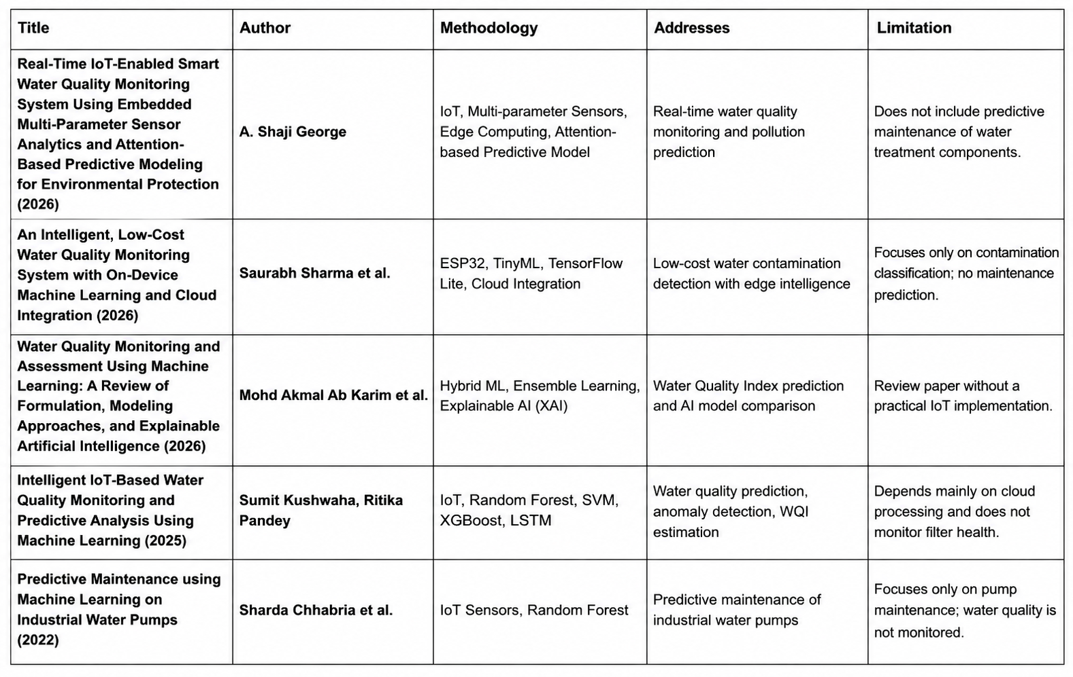
Literature Review :

Slide 5
Research Gap :
From the reviewed studies, the following gaps are identified:
Many existing systems mainly monitor and display sensor values.
Conventional systems often depend on fixed thresholds for detecting unsafe water.
Water-quality monitoring and filter maintenance prediction are not always integrated.
Limited systems provide a combined Filter Health Index and Water Quality Risk Score.
Existing monitoring systems may not explain why water is classified as unsafe.
Maintenance activities are often reactive rather than prioritized according to the condition of multiple stations.
Public users may not have direct access to real-time water-quality and maintenance information.
Proposed Research Gap Addressed by PUREXAI
PUREXAI aims to integrate:
IoT Monitoring + AI Analysis + Filter Health + Risk Scoring + Predictive Maintenance + Explainable AI + Maintenance Priority + Alerts + QR Public Information
This makes the proposed system more proactive, intelligent and maintenance-oriented.

Slide 6
Proposed Methodology :
Sensor Layer
TDS • Turbidity • Temperature • Suspended Particles
ESP32 Data Acquisition
Collects and processes sensor readings.
Wi-Fi Communication
Transfers readings to the backend server.
Database
Stores real-time and historical sensor data.
AI Processing
Water Safety → Filter Health → Risk Score → Predictive Maintenance → XAI
Output & Alerts
Dashboard • OLED • Buzzer • LEDs • Notifications • QR Portal

Slide 7
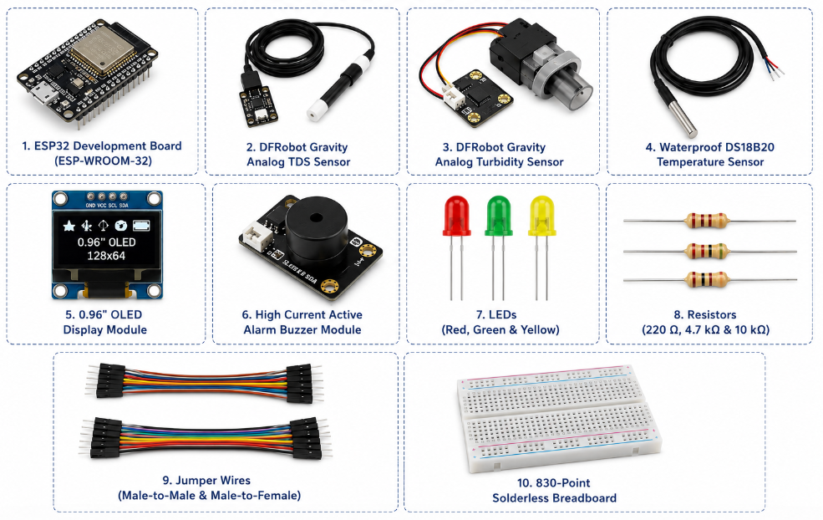
Hardware Requirements :

Slide 8
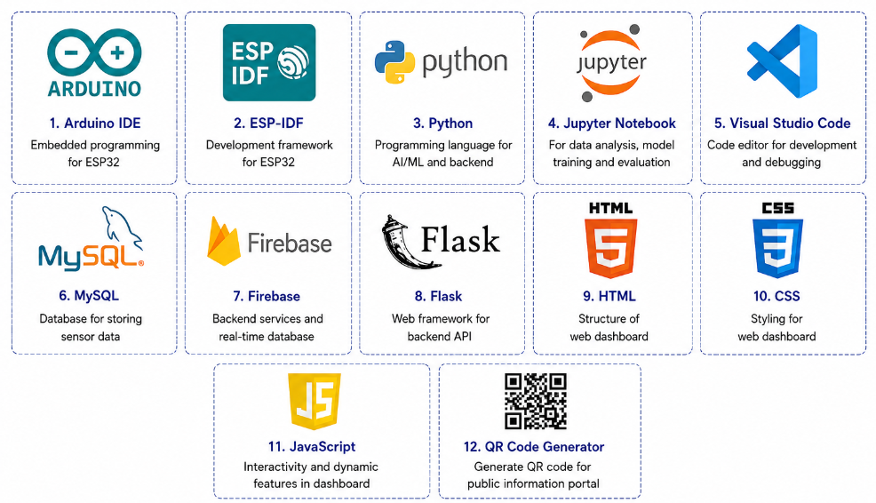
Software Requirements :

Slide 9
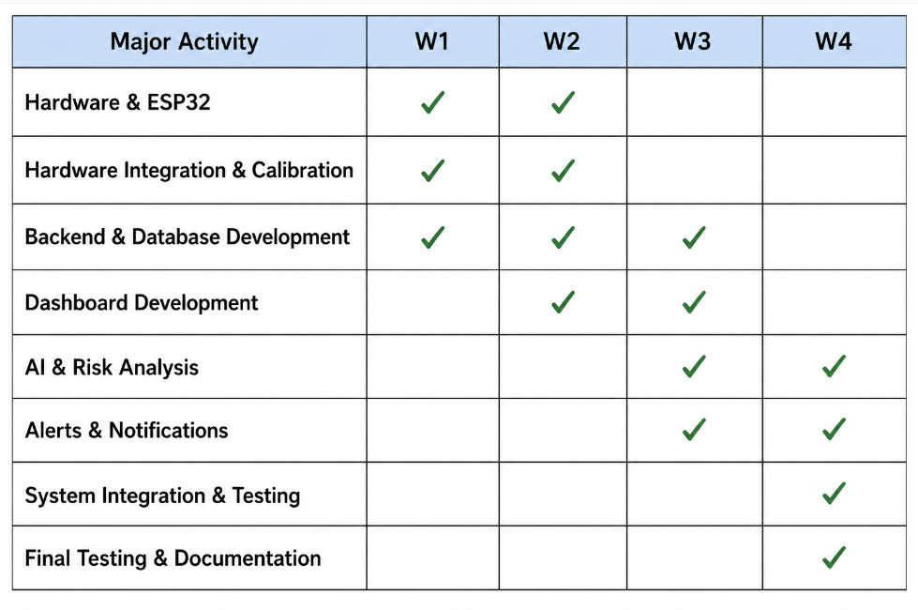
Gantt Chart :

Slide 10
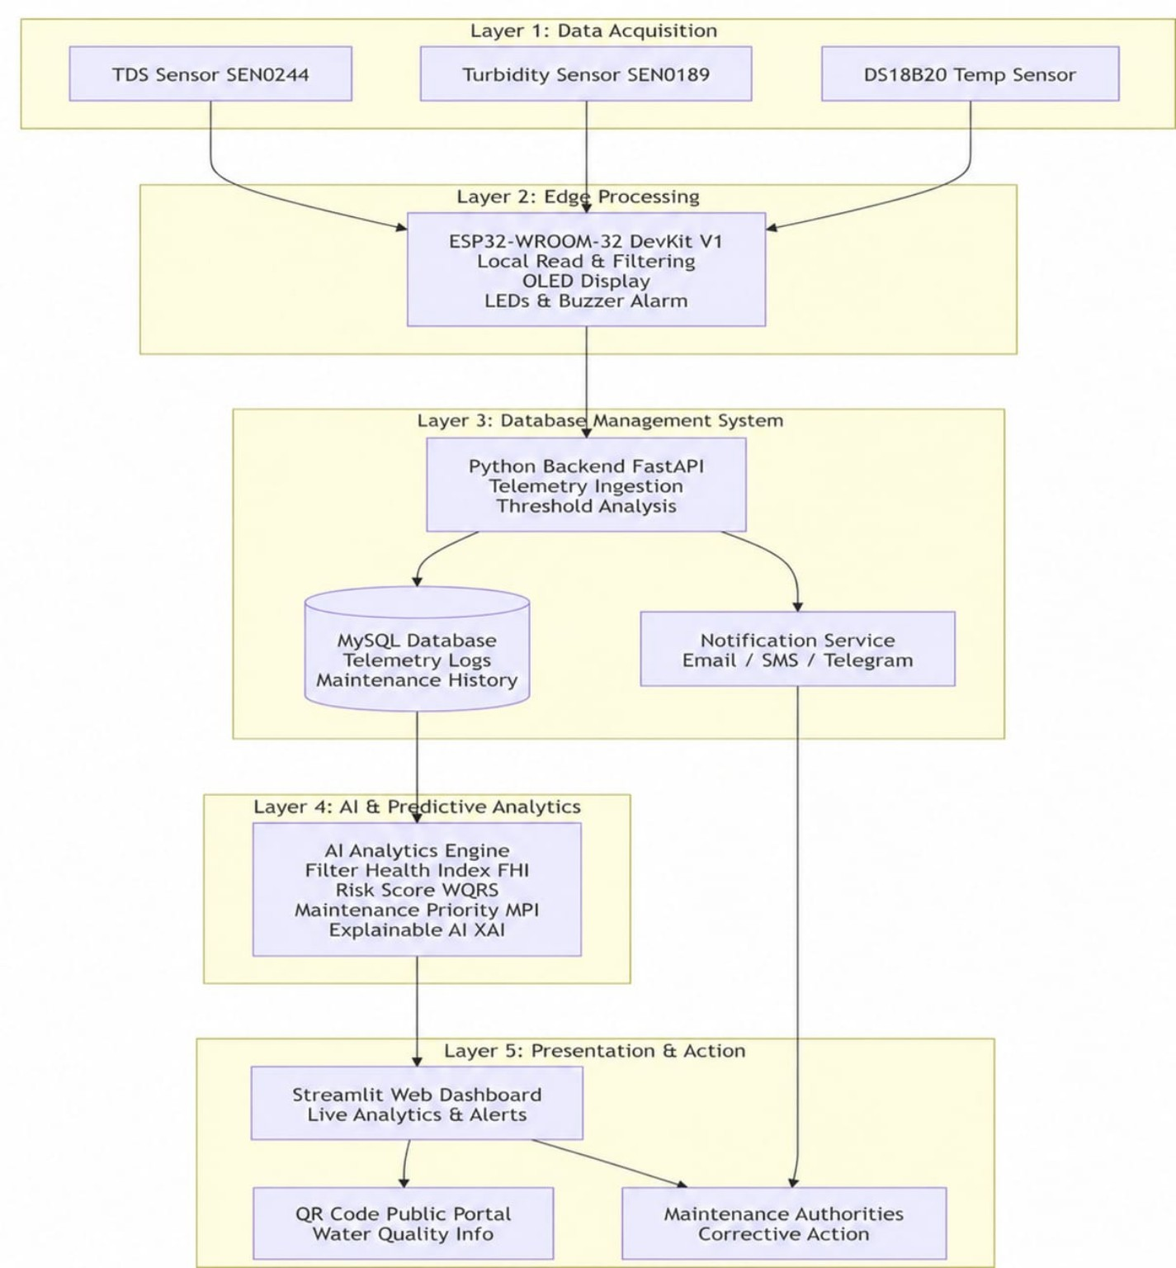
System Design
Layer 1 — Data Acquisition
TDS + turbidity + DS18B20 temperature sensors.
Layer 2 — Edge Processing
ESP32 reads/filters data; OLED, LEDs and buzzer provide local indication.
Layer 3 — Data Management
FastAPI telemetry ingestion + MySQL storage + notification service.
Layer 4 — AI & Predictive Analytics
Filter Health Index, filter-life prediction and Water Quality Risk Score.
Layer 5 — Presentation & Action
Streamlit dashboard + QR public portal + maintenance authorities.
3

Slide 11
Module-wise Implementation
M1 Sensor Acquisition
M2 ESP32 Edge Node
Implemented
Implemented
TDS, turbidity and DS18B20 temperature readings
Local read/filtering, OLED display, LEDs/buzzer
M3 Wi-Fi Telemetry
M4 Backend & Database
Implemented
Implemented
Transmit observations to monitoring backend
FastAPI ingestion, threshold analysis, MySQL logs
M5 AI Analytics
M6 Risk Scoring
Implemented
Implemented
Random Forest filter-state + remaining-life prediction
WQRS from sensor deviation, inverse FHI and trend
M7 Dashboard & Alerts
M8 Public QR Portal
Implemented
Implemented
Live dashboard, alert history, sensor health
Tap-specific quality and maintenance information
4

Slide 12
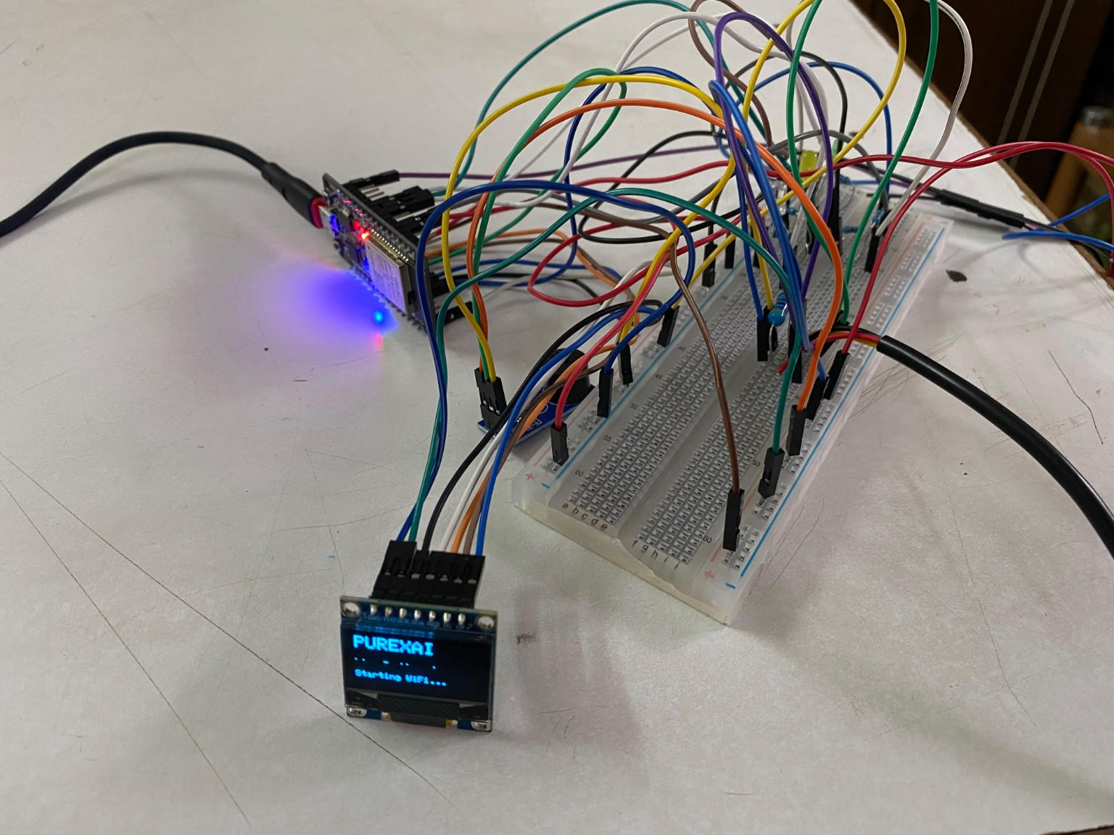
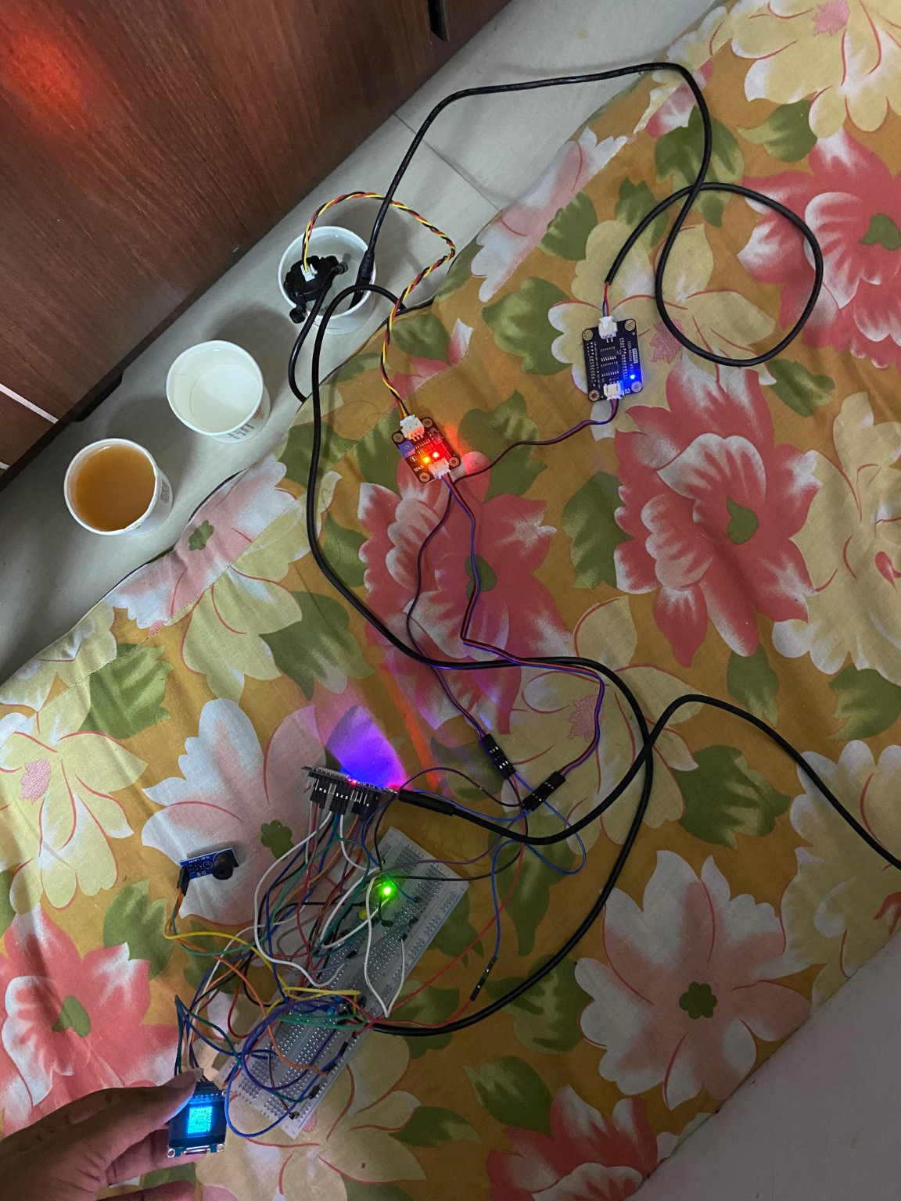
Prototype — Hardware & Physical Integration
Controller
Sensors
Local Interface
Connectivity
ESP-WROOM-32 for sensor acquisition and communication.
DFRobot Gravity Analog TDS + Turbidity + Waterproof DS18B20.
0.96-inch 128×64 OLED + buzzer driver + LEDs.
Wi-Fi to backend/dashboard; tap-specific public information via QR.
5

Slide 13
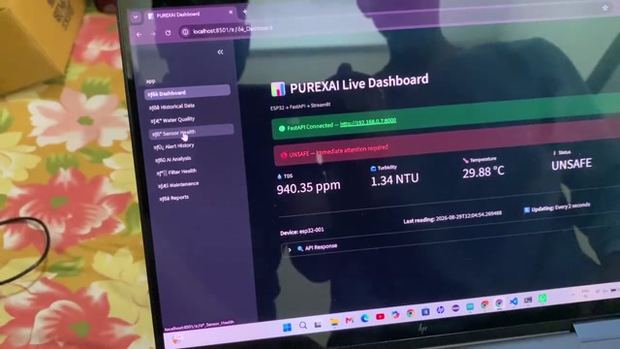
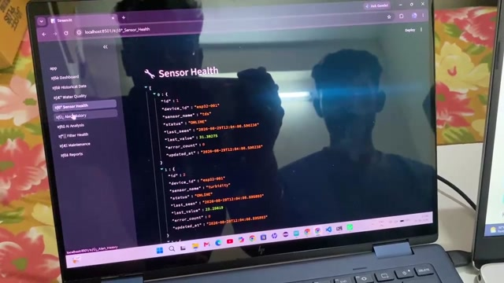
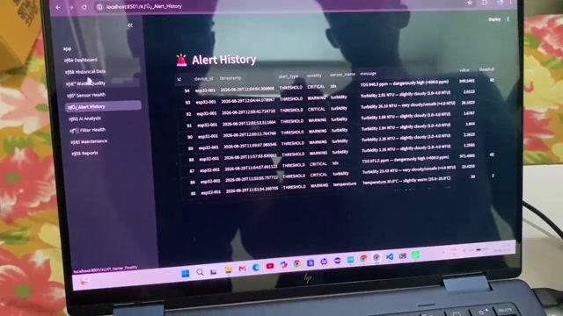
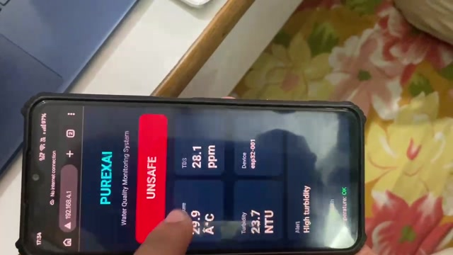
Prototype — Working Demonstration
Live Dashboard
Sensor Health
Alert History
TDS, turbidity, temperature and UNSAFE status
Device/sensor health information and status
Stored threshold alerts with severity and sensor source
Mobile alert view also demonstrated
Demo evidence
The video shows the dashboard, sensor-health page, alert-history page and a mobile water-quality alert.
6

Slide 14
Testing Progress
Acquire
Validate
Prepare
Train / Validate / Test
Evaluate
1
2
3
Five-sample moving median where appropriate; normalize inputs to [0,1]
4
5
3 taps • 60 s sampling • 10 days
Calibration, invalid values, missing data, noise filtering
70% / 15% / 15% chronological split
Accuracy, precision, recall, F1, MAE and alert latency
350
245
36.75
36.75
Total time-stamped observations
Training observations (70%)
Validation observations (15%)
Held-out test observations (15%)
Classification testing
System-level testing
Filter-state classes: Healthy, Warning, Critical. Metrics considered: accuracy, precision, recall and F1-score.
Filter-life prediction evaluated using MAE; alert latency measured over 100 alert events.
7

Slide 15
Testing Results
Results reported from the held-out test data.
92.4%
0.91
2.8 days
0.93
Filter-state classification accuracy
Filter-state F1-score
Filter-life prediction MAE
WQRS classification F1-score
Filter Health Index (FHI)
Water Quality Risk Score
Alert Response
0–100 operational index: Healthy ≥75, Warning 50–74, Critical <50.
Low 0–24 • Moderate 25–49 • High 50–74 • Critical 75–100.
100 alert events evaluated; mean measured alert latency: 2.1 s.
Interpretation
The measured results support feasibility of combining low-cost IoT sensing with ML-based filter assessment, risk classification and near-real-time warning. They are decision-support outputs, not certification of drinking-water safety.
8

Slide 16
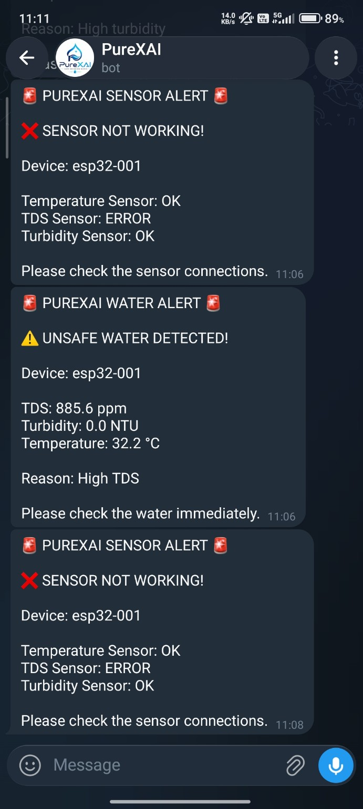
Testing Challenges
Sensor reliability
Connectivity
The demo includes a TDS sensor error alert. The paper also identifies sensor drift and calibration uncertainty as limitations.
Continuous telemetry depends on reliable Wi-Fi communication; the paper lists possible connectivity interruptions.
Generalization
Class imbalance
Water sources and public facilities differ; broader datasets are needed to strengthen generalizability.
It identifies class imbalance as a possible limitation for AI evaluation.
Demo evidence
Improvement direction
Telegram-style sensor alert reports:
Temperature OK, TDS ERROR, Turbidity OK.
Larger multi-location datasets • stronger laboratory ground truth • more sensor types • edge-AI • anomaly detection • improved filter-life prediction • explainable AI.

Slide 17
IEEE Conference Paper — TOC
Part A — System & Intelligence
Part B — Implementation, Evaluation & Closing
• I. Introduction
• II. Related Work
• III. Problem Statement and Objectives
• IV. PUREXAI System Architecture
• V. Water-Quality Data Acquisition
• VI. Data Preprocessing and Feature Engineering
• VII. AI-Based Filter Health Index
• VIII. Filter Replacement Prediction
• IX. Water Quality Risk Score
• X. Dashboard, Alerts, and QR System
• XI. System Implementation
• XII. Experimental Methodology
• XIII. Performance Metrics and Calculation
• XIV. Results and Discussion
• XV. Comparison with Previous Literature
• XVI. Security, Reliability, and Responsible AI
• XVII. Limitations
• XVIII. Future Work
• XIX. Conclusion
• References

Slide 18
Conclusion
End-to-end system
Prototype outcome
PUREXAI integrates water-quality sensing, ESP32 edge processing, backend storage,
AI analytics and user-facing alerts.
The prototype demonstrates TDS, turbidity and temperature monitoring with dashboard
and mobile/alert interfaces.
Key findings
Limitations
The supplied evaluation reports 92.4% filter-state accuracy, 0.91 F1, 2.8-day filter-life MAE,
0.93 WQRS F1 and 2.1 s mean alert latency.
Sensor drift/calibration, connectivity interruptions, class imbalance and
limited data diversity remain challenges.
Future direction
Expand datasets and laboratory ground truth; add sensors, anomaly detection, edge-AI
and improved predictive maintenance.

Slide 19
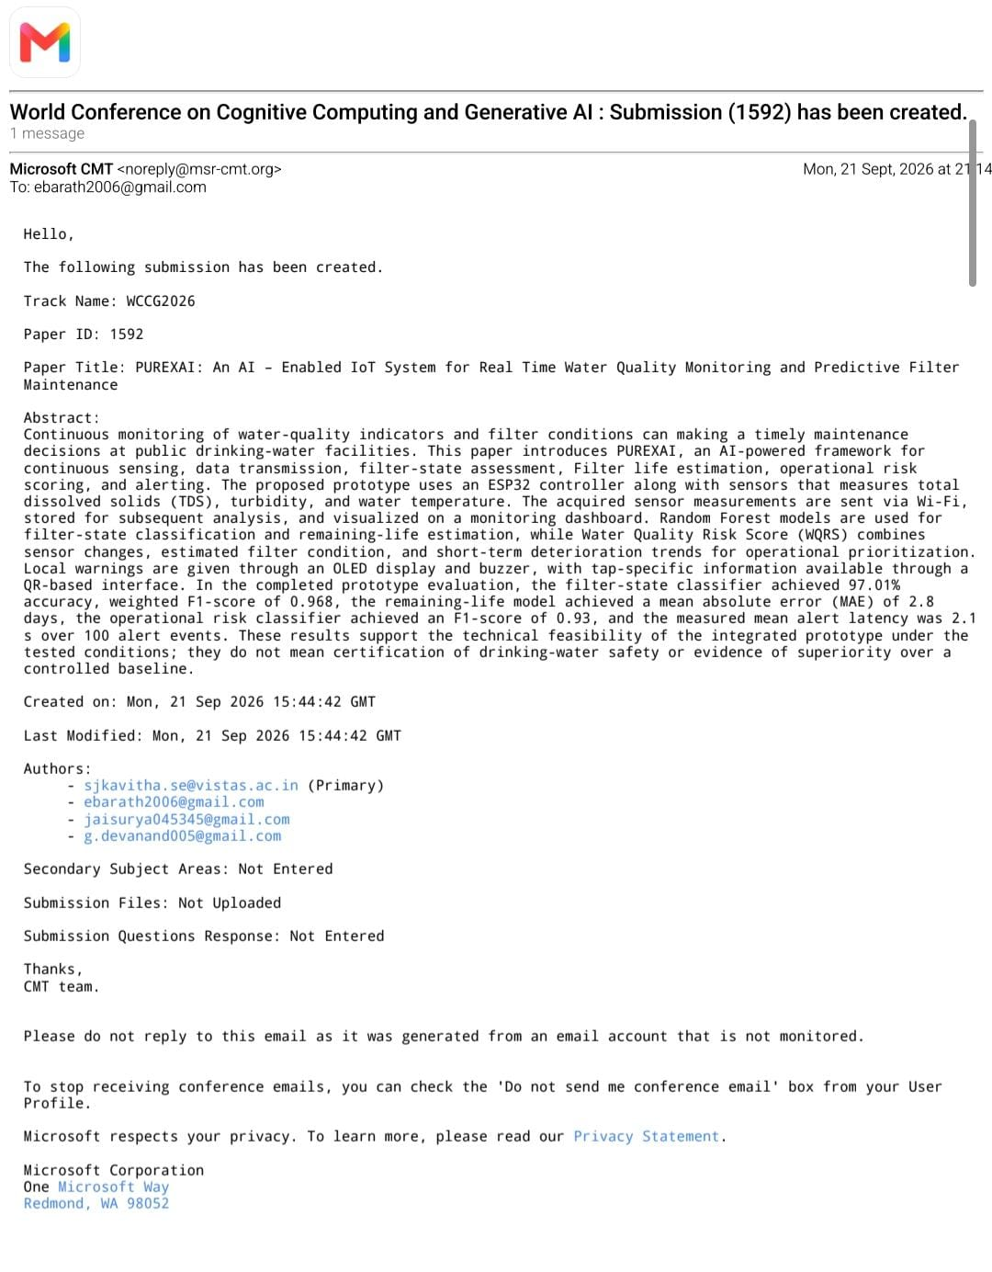

Slide 20
THANK YOU
AI • IoT • Water Quality Monitoring • Predictive Maintenance
Barath Kumar E (23619106) • Jai Surya S (23619117) • Devanand G (23619109)
Under the Guidance of Mrs. SJ Kavitha
12

